Slide 1


Arduino
Programming
Here starts the lesson!

Slide 2

01
Control Operators

Slide 3

If Statement
Demo
Overview
Void setup()
{
Serial.begin(9600);
}
Void main() {
/* local variable definition */
Int a=10;
/* check the Boolean condition using if statement*/
If(a<20){
/* if condition is true then print the following*/
Serial.println(“a is less than 20\n);
}
Serial.printf(“value of a is: %d \n”,a);
}
An if statement consists of a Boolean expression followed by one or more statements.
If the Boolean expression evaluates to true, then the block of code inside the 'if' statement will be executed.
If the Boolean expression evaluates to false, then the first set of code after the end of the 'if' statement (after the closing curly brace) will be executed.

Slide 4
02
If…Else Statement

Slide 5

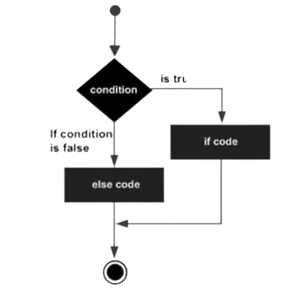
Introduction
An if statement can be followed by an optional else statement, which executes when the Boolean expression is false.
If the Boolean expression evaluates to true, then the if block will be executed, otherwise, the else block will be executed.

Slide 6

Void setup()
{
Serial.begin(9600);
}
Void main() {
/* local variable definition */
Int a=10;
/* check the Boolean condition using if statement*/
If(a<20){
/* if condition is true then print the following*/
Serial.println(“a is less than 20\n);
}
Else
{
Serial.printf(“value of a is not less than 20: %d \n”);
}

Slide 7
03
Nested If statement

Slide 8
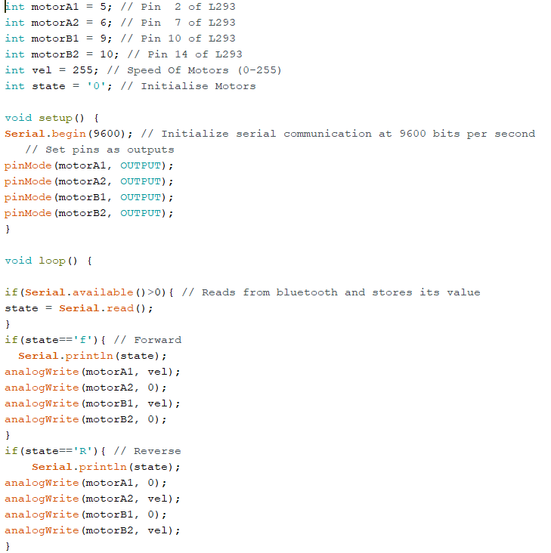
It is always legal in C programming to nest if-else statements, which means you can use one if or else if statement inside another if or else if statement(s).

Slide 9
04
Switch statement

Slide 10
Overview:
Variable you test against the cases
A switch statement allows a variable to be tested for equality against a list of values. Each value is called a case, and the variable being switched on is checked for each switch case.
switch(range){
case 0:
Serial.println(“low”);
break;
case1:
Serial.println(“mediam”);
break;
case2:
Serial.println(“high”);
break;
}
The break keyword lets the program know the case is complete

Slide 11
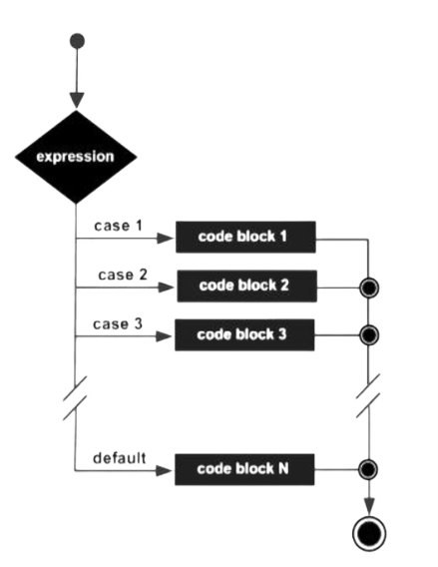
Flowchart

